Slide 1

Predicting Windfarms Impact on Home Values
Final Report

Slide 2
Objective
Build a model that can be used to predict the change in value of a home
Assess if a windfarm in the vicinity of a home impacts the value of the home
Home owners, home buyers, & local government officials interested in tax revenue can use this model to predict the likelihood that a wind farm will impact home prices.

Slide 3
Contents
1
About the Data
2
Observations
3
Machine Learning
4
Summary

Slide 4

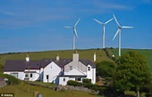

About the Data Sources
US Wind Turbine database as a csv file
The United States Wind Turbine Database (USWTDB) provides the locations of land-based and offshore wind turbines in the United States, corresponding wind project information, and turbine technical specifications.
Zillow Housing Data as a csv file
Zillow Home Value Index (ZHVI) is a smoothed, seasonally adjusted measure of the median estimated home value across a given region and housing type. Zillow provides data on sold homes, including median sale price for various housing types, and sales volume
US Zipcode Database as a csv file
uszipcode is a feature-rich zipcode database with a zipcode search engine that can be customized to the desired search results.

Slide 5
About the Data Features of Highest Interest
Features that appear most significant to impact a home’s value
and
assess if windfarms impact home values
are
Annual change in median home value (as a percentage) for zip codes with wind farms and zip codes 25 miles away without wind farms
Population density of zip codes with wind farms and adjoining or nearby zip codes without wind farms
Median income of zip codes with wind farms and adjoining or nearby zip codes without wind farms

Slide 6
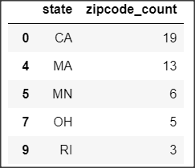
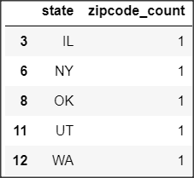
Observations Windfarm Locations
States with highest and lowest count of zip codes with windfarms…
Highest 5
Lowest 5
6

Slide 7
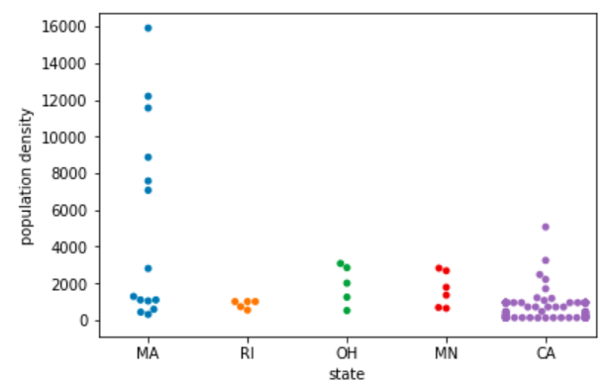
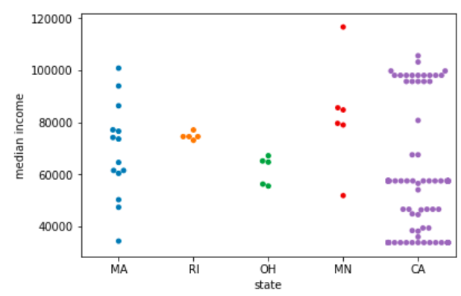
Observations Population and Income (1 of 2)
MA has several windfarms in areas w/high population densities
CA has a number of windfarms in areas with a high median income
Population Density
Median Income

Slide 8
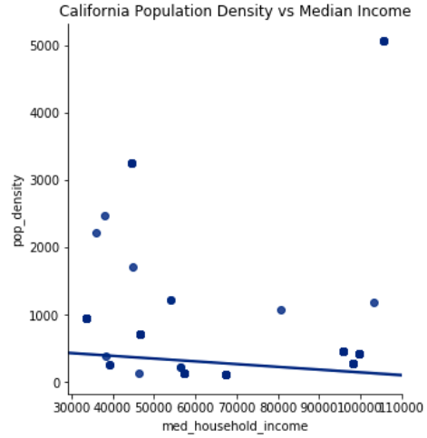
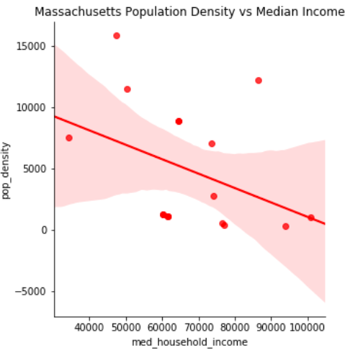
Observations Population and Income (2 of 2)
California
Massachusetts
8

Slide 9
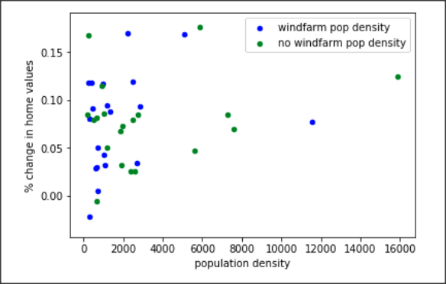
Observations Correlations (1 of 2)
The correlation coefficient between Population Density & Mean % Change in Home Values differs by only 2%
Correlation of zip codes with windfarms:
Correlation of zip codes without windfarms:
23%
25%

Slide 10
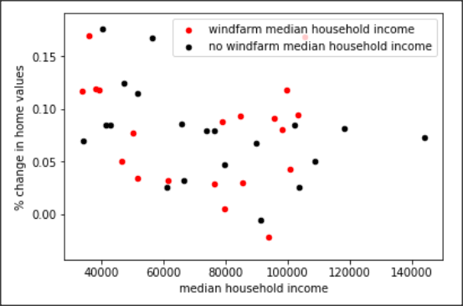
Observations Correlations (2 of 2)
The correlation coefficient between Median Income & Mean % Change in Home Values differs by 22%
Correlation of zip codes with windfarms:
Correlation of zip codes without windfarms:
19%
41%

Slide 11
Observations Significance
Using 2017 data, there is not a statistically significant difference in mean home values for zip codes with versus without windfarms
= $50,000
Mean home value for zip codes with windfarms
Mean home value for zip codes without windfarms
$360,000
$400,000
Difference:
$40,000
p-Value
Difference in value 95% confidence Interval
0.99
-$90,000 to $188,000

Slide 12
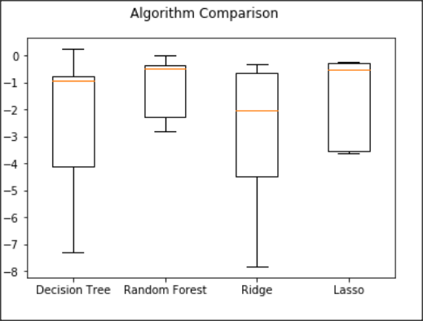
Machine Learning
Four algorithms were employed to research a model for predicting home values…
Points of interest to learn from the box chart...
All the algorithms produce a similar top, but Random Forest and Lasso appear have the highest top and a much tighter range than Ridge or Decision Tree. These appear to be the best models for further analysis.
Random Forest’s plot is short and Lasso has very short whiskers indicating a high level of agreement on home value predictions across zip codes.
Height of the Decision Tree and Ridge plots are similar, and are much greater than Random Forest and Lasso. This lends further support to not continuing with the Decision Tree and Ridge algorithms.
The medians of Decision Tree, Random Forest, and Lasso are very similar, but the size of their box plot varies, showing a much higher variance in the Decision Tree results.

Slide 13
Summary
Restatement of Objectives…
Build a model that can be used to predict the change in value of a home
Assess if a windfarm in the vicinity of a home impacts the value of the home
Key Conclusions…
Using a Random Forest Algorithm a model predicting home values with 77% accuracy was achieved
The presence of a windfarm does not appear to have an impact on home values in the surrounding area
The most significant predictor is population density, followed closely by median income.
For median income, correlation to home values is much lower for zipcodes with a windfarm than zipcodes without a windfarm (19% versus 41%). A potential reason is windfarms may tend toward more rural areas and in rural areas median income may be less of a factor on home values.
Not surprisingly, windfarms are primarily in rural areas, though several zip codes with high population density and high median incomes host windfarms

